Slide 1



Sentiment Analysis using Azure Data Factory in 10 minutes
Azure Cognitive Services – TextAnalytics

Slide 2





Presenter
Alpa Buddhabhatti
Azure Consultant, Cluster Reply
https://www.linkedin.com/in/alpabuddhabhatti/

Slide 3
Abstract
In this session, I will show demo about how you can know customer perception by applying sentiment analysis on customer feedback data without knowing Maths, Data science and Machine Leaning and programming language. This session will used following technology: **Azure Data Factory **Azure Cognitive Service(Text Analytics) **Azure Blob Storage **Azure SQL Server **Azure Key Vault Attendee will leave with quick ideas about above technology.

Slide 4
Agenda
1. Azure Data Factory in 1 minute
2. Sentiment analysis 1 minute
3. Demo :
How to apply Sentiment Analysis on your data using above two azure services

Slide 5
Azure Data Factory in 1 minute
A cloud-based data integration service
Orchestrates and automates your Data Pipelines
Azure PaaS Service
It is Serverless
Only pay for what you have use
No code or Low code
Search | Microsoft Docs

Slide 6
Sentiment analysis in 1 Minute -
Azure Cognitive service for Language
Text Analytics (Text, Documents)
Extract, Classify and Understand text within documents
Sentiment labels (such as "negative", "neutral" and "positive")
NLP - Natural Language processing technique
No code or Low code
Create an Azure Language resource
The REST API or the client library for C#, Java, JavaScript, and Python
Text Analytics | Microsoft Azure

Slide 7
Azure Cognitive Services – TextAnalytics
DEMO

Slide 8

DEMO
Scenarios :
Moving data files from Azure Blob storage to Azure SQL Server. Transforming data using Azure data flow.
Following Azure resources needed per environment
Azure Resource group
Azure Data factory
Azure Blob Storage
Azure SQL Server
Azure Key Vault
Azure Cognitive Services

Slide 9



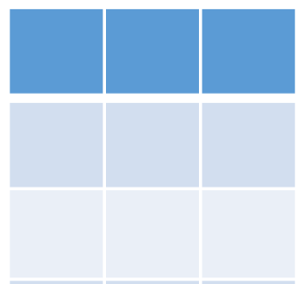




Solution
Azure Cognitive Services – TextAnalytics
Azure Blob Storage
(feedback-in)
2
Azure SQL Server
1
3
Azure Data Integration Platform - ADF
*.csv
Azure Key vault

Slide 10
Key Takeaway
Azure Data Factory
A Could based data integration service
Data Movement, Transformation at scale and provide Orchestration
More than 100 data sources
Azure Cognitive Service for Language – Text Analytics
It summarized big documents and provide sentiments
Understand common topics and trends
A wide range of languages
A Gain deeper understanding about your customer sentiments

Slide 11
Thank you !!!!

